Slide 1
DC Distribution system design and implementation
for Green Building
2011.12.02
Power Electronics System Lab.
Seoul National University, KOREA
Professor Bo Hyung Cho

Slide 2
Table of Contents
I
Introduction
II
DC Building Research in KOREA
III
DC System Model & Design
IV
Implementation of the DC System
V
Conclusion and Future Works

Slide 3
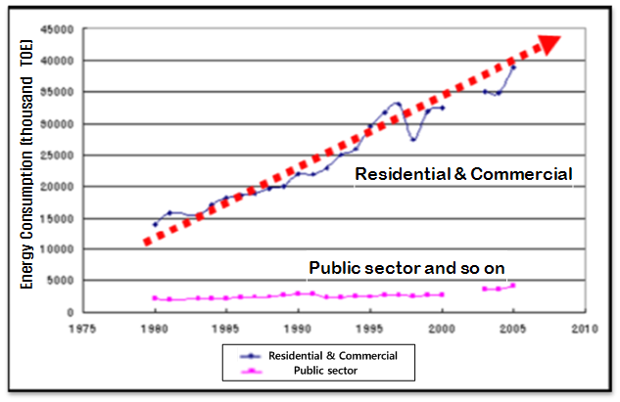
Introduction
Buildings consumed 23% of Total Energy in Korea (at 2005)
Energy consumption in the Buildings is continuously increased
Total Energy Consumption rate
In KOREA (2005)

Slide 4
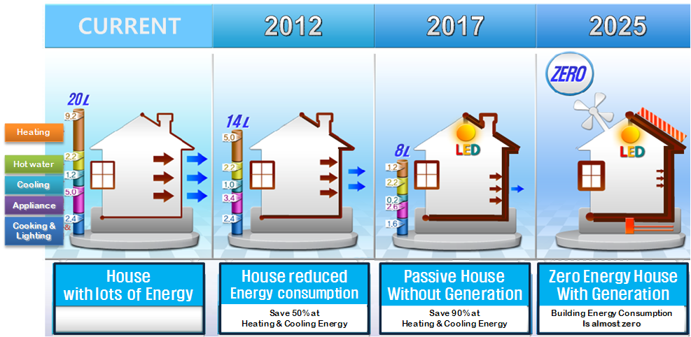
Introduction
Action Plan for a building Energy Management
[Ministry of Land, Transport and Maritime Affairs, KOREA]
DC distribution in a Building is one of possible solutions
The quantity of a fossil fuel consumed (per unit area)

Slide 5
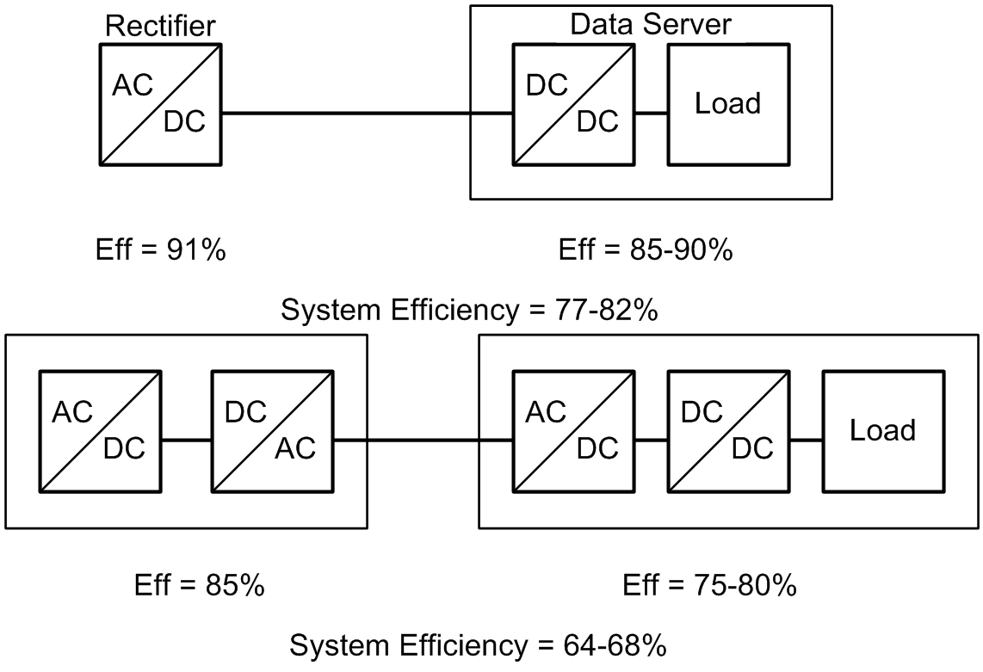
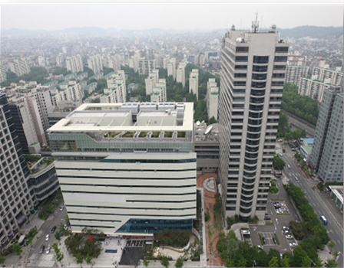
DC Building Research in KOREA
DC-distributed Internet Data Center : KT corps.
[Operated IDC based on DC distribution from 2008]
48V, 380V DC Distribution System
13.2%, 25% Efficiency Increasing
Elimination of AC UPS & STS (Cost saving)
Reliability Improvement
Mok-Dong Internet Data Center, Seoul, Korea
Sung-Yong Son, et al, “A Comparative Study on the Electric Power Efficiency of IDCs with AC and DC Distribution Systems,” Journal of the Korean Institute of Illuminating and Electrical Installation Engineers, Vol. 22, pp. 38-44, Aug. 2008.

Slide 6
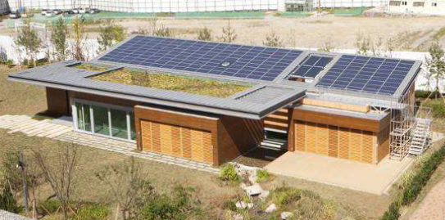
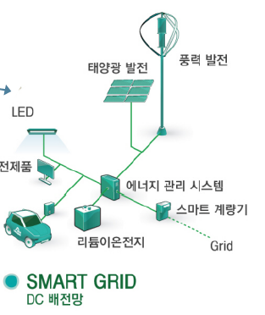
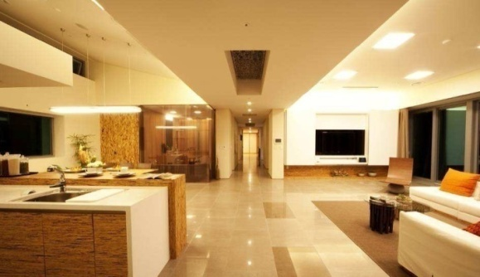
DC Building Research in KOREA
Green Tomorrow : Samsung C&T Corp.
[Open to the public from 2009]
(22.1%) (62.1%)
(14.2%) (13.5%) (35.6%)
DC distribution and DC appliances (30kW)
DC-based Power Sources
- Solar (22kW), Wind (3kW), Fuel Cell (200W)
DC-based Energy Storage
- Li-ion Battery (22kWh)
1.5~3% Efficiency Improvement
Energy usage < Energy generation (for total life cycle) – Zero Energy House
PV Power
Wind
Power
DC Appliances
LEED Platinum
Energy Management System
Electric
Vehicle
Smart Meter
Li-ion Battery
DC Distribution

Slide 7
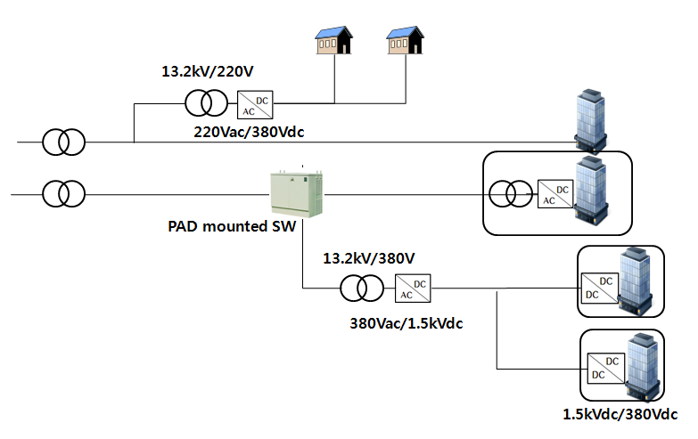
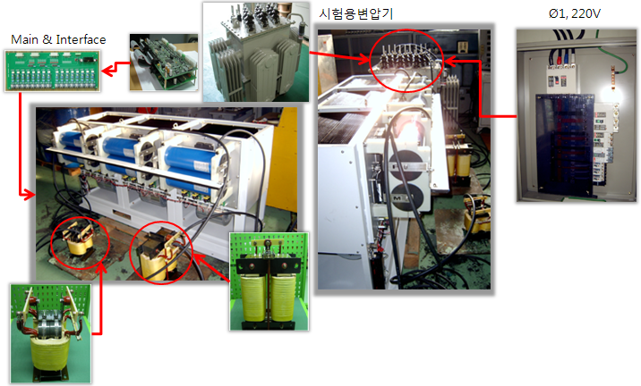
DC Building Research in KOREA
DC Transmission : Korea Electric Power Corp.
[Study the DC transmission(Plan) with the Green DC Building Research from 2010]
Prototype Power Converter Hardware (Currently 6.6kV [30kVA], Target – 13.2kV)

Slide 8
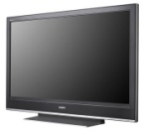
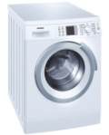
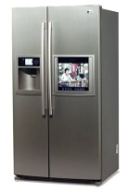
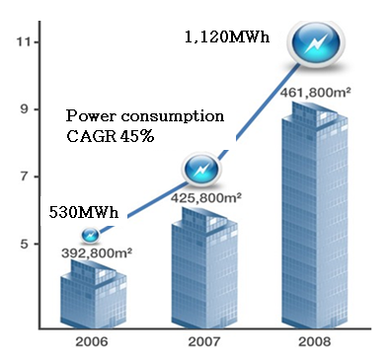
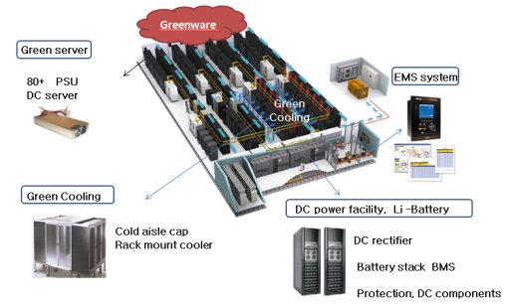
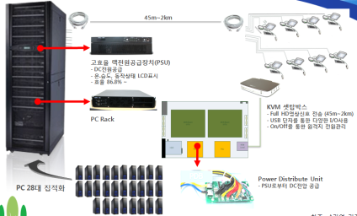
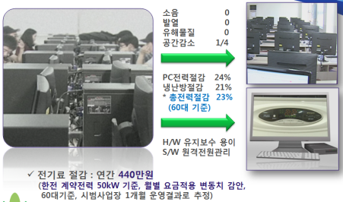
DC Building Research in KOREA
DC Appliances : Samsung Electronics Corp.
[Develop DC Appliance and Modify AC SMPS to DC SMPS from 2010]
IDC Standardization : Korea Electro Technology Research Institute
[Study IDC Standardization based on DC distribution from 2010]
Green IT DC distribution : Korea Electronics Association
[Promote the Dissemination of Green IT & Green PC (based on DC equipment from 2010]

Slide 9
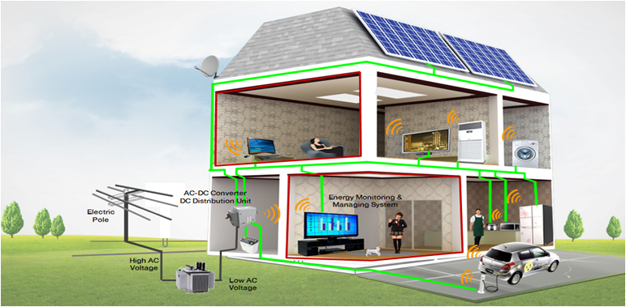
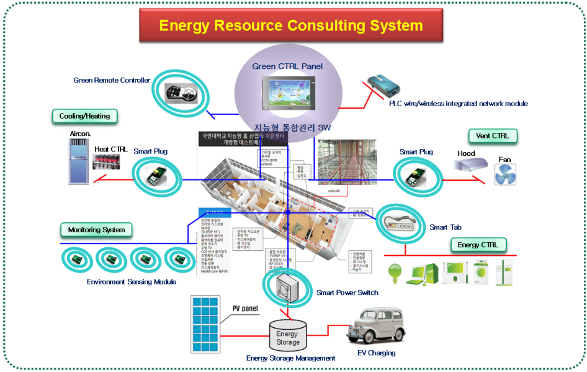
DC Building Research in KOREA
Green DC Building TestBed with Green IT Project
[Supported by Korean Ministry of Knowledge Economy, 4 years project – about $1M]
DC distribution, Energy Management and Environment-friendly Building
Issues
- DC distribution Realization
- Energy Management System
- Energy Performance Evaluation
- Database Establishment
- Industrial Vitalization

Slide 10
DC System Model & Design
Standard Voltage Decision – Why 380V ?
DC Demonstrations
USA | Korea | France | Japan | Sweden | New Zealand
Intel (380V) Univ. CA SD (380V) Univ. Syracuse (550V) | Univ. Seoul Natl’ (380V) KT (310V) Samsung C&T (310V) | Orange (380V) France Telecom (380V) | NTT (380V) NEDO Sendai Project (300V) Etc. (350V) | UPN AB (350V) | NZ Telecom (220V)
Decision Factors
- Power Loss, Voltage Drop - Cost - Safety
- Efficiency - Grounding (IEC)
Ref : DC Characteristics analysis of various AC loads for Hybrid Distribution

Slide 11
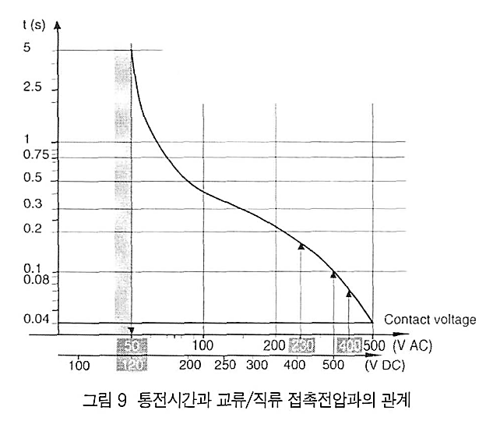
DC System Model & Design
Cost
Safety
Characteristic curve of body current/duration of AC and DC current flow
400Vdc is equivalent to 230Vac in respect of safety
(Advantage of DC distribute system)
Relationship between duration and AC/DC contact voltage

Slide 12
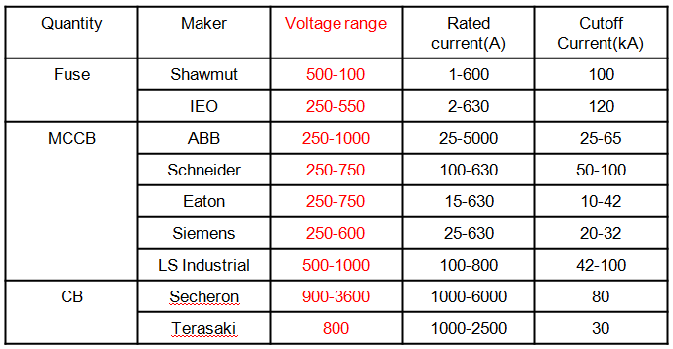
DC System Model & Design
Compatibility
380Vdc level is chosen to match the industry-standard intermediate DC voltage in consumer electronics with the PFC (Power Factor Correction) circuit at the input side.
AC system peak voltage
- USA: 120Vrms (170Vpp) - KOREA: 220Vrms (311Vpp)
- JAPAN: 100Vrms (141Vpp) - UK: 240Vrms (339Vpp)
Rated voltage of circuit elements: 400V to 450V (ex, electrolytic capacitor etc)
Compatible with PV PCS, EV Charger (Output of PCS: 150 to 600V)

Slide 13
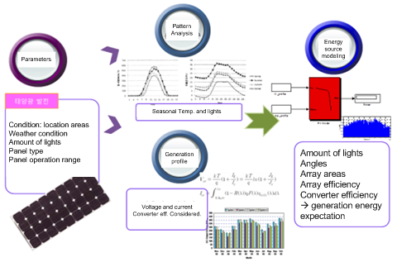
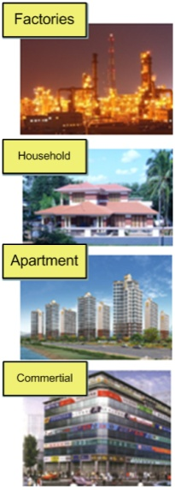
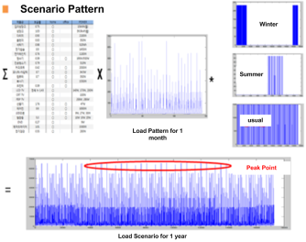
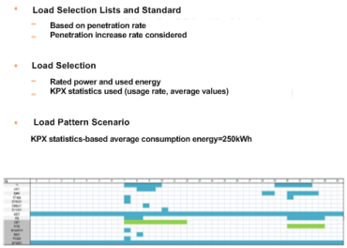
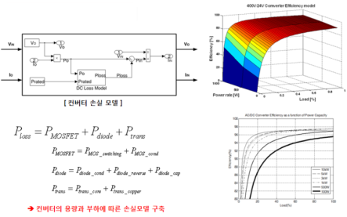
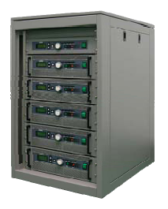
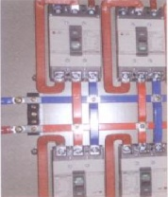
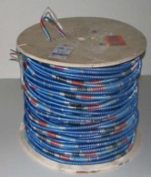
DC System Model & Design
Development of DC Distribution System Design Software Tool
Load Type
component
Consumption
Generation Profile
Green Building System Design Software
Distributed Sources and Battery
DC System Component
Eff. Loss Modeling
System Design
Capacity
Wiring
Renewables
System Structure
Analysis
DC technologies

Slide 14
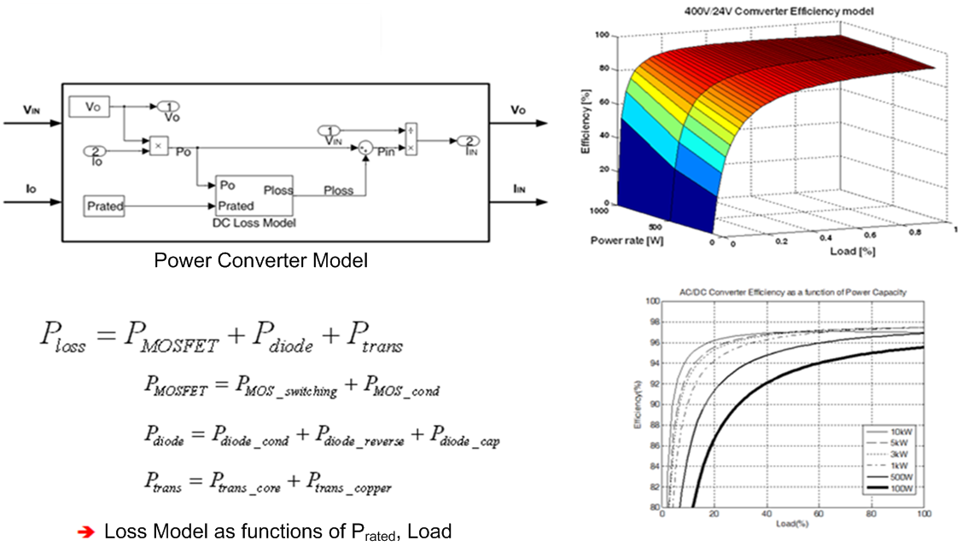
DC System Model & Design
Component Modeling – Power Converter
Input Parameter: Input Voltage & Load Current
Output Parameter: Efficiency of Power Converter

Slide 15
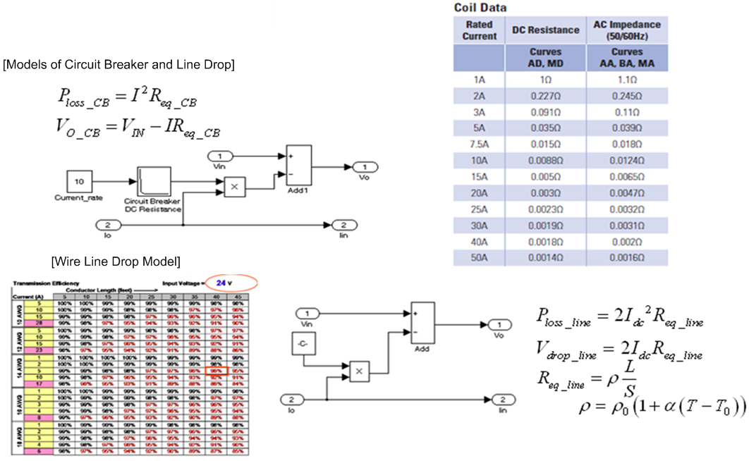
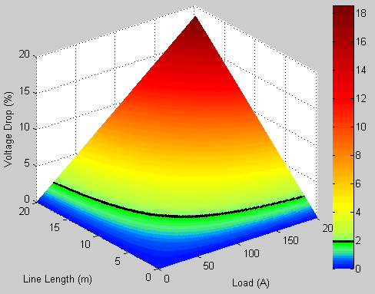
DC System Model & Design
Component Modeling – Circuit Breaker, Line Drop
Voltage drop -2% (limit)

Slide 16
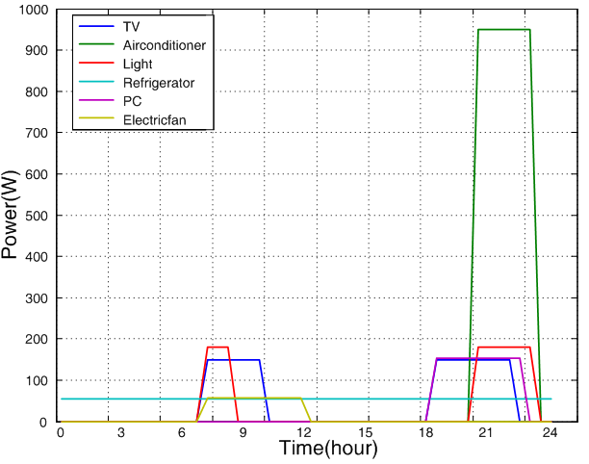
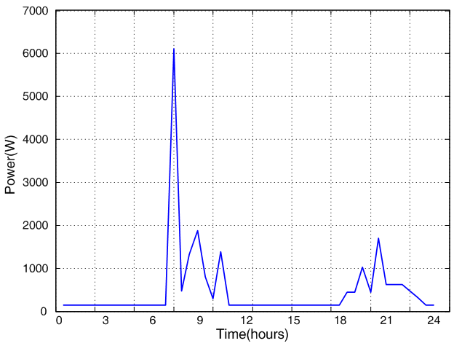
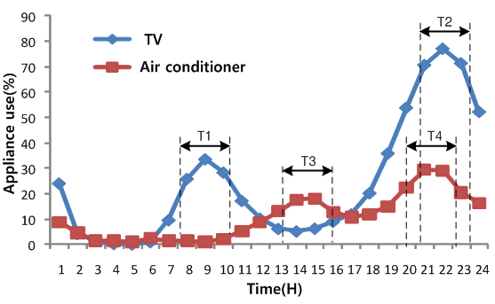
DC System Model & Design
Power Consumption Scenario
Statistics-based (4,000 households included)
Timing determination based on probability of usage
Random function used to simulate the randomly used appliances
 | Power (W) | Days (days/month) | Usage (min/month) | Usage (Wh/month) | Usage (Wh/year)
TV | 149.1 | 27.1 | 350 | 23,510 | 293,625

Slide 17
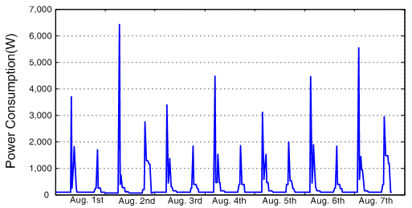
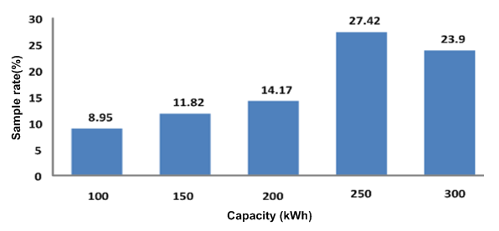
DC System Model & Design
Power Consumption Scenario
Average Energy: 250 kWh/month (KEPCO)
Households classified to 3 types by wattages and used loads
- Lightings, Kitchen Appliances, Seasonal Appliances
Example of Power Consumption Pattern (1 day, Summer)

Slide 18
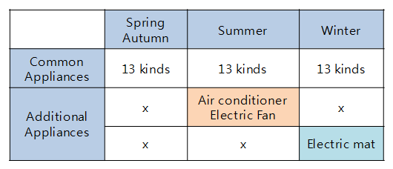
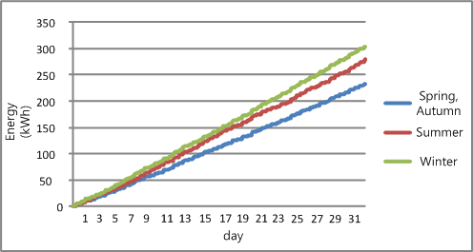
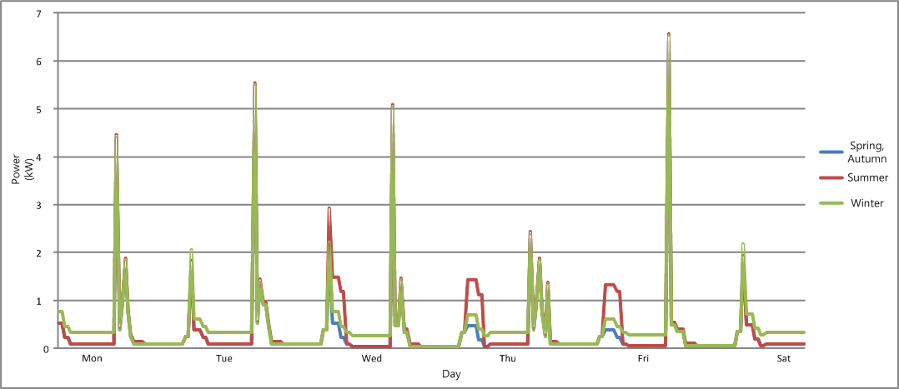
DC System Model & Design
Comparison of Seasonal Power and Appliance addition
Maximum peak Power : 6.60kW (summer) , 6.55kW(winter)
Average Usage : 279kWh(summer) , 304kWh(winter)

Slide 19
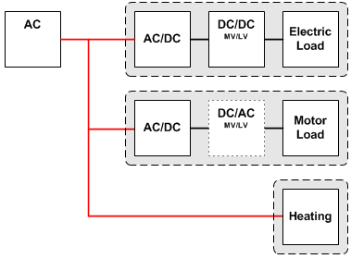
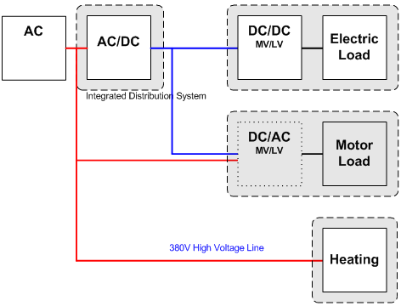
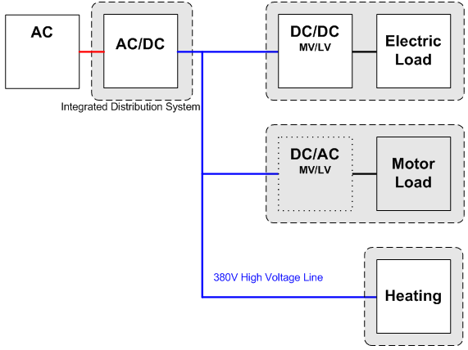
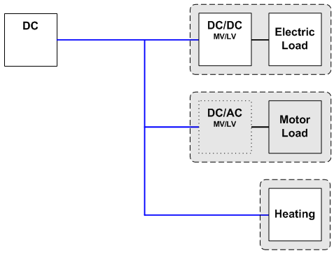
DC System Model & Design
Simulation of the Effectiveness of DC Distributed System
4 different kinds of Power System Architecture
AC | Hybrid | DC(D) | DC(T)
Input Voltage | 100~230V | AC, DC | 380VDC | DC
Main Power | In device | Integrated | Integrate | In PDU
Renewable Energy | Bad | Good | Excellent | Excellent
Reliability | Normal | Low | High | Excellent
Energy Efficiency | Poor | High | High | Excellent

Slide 20
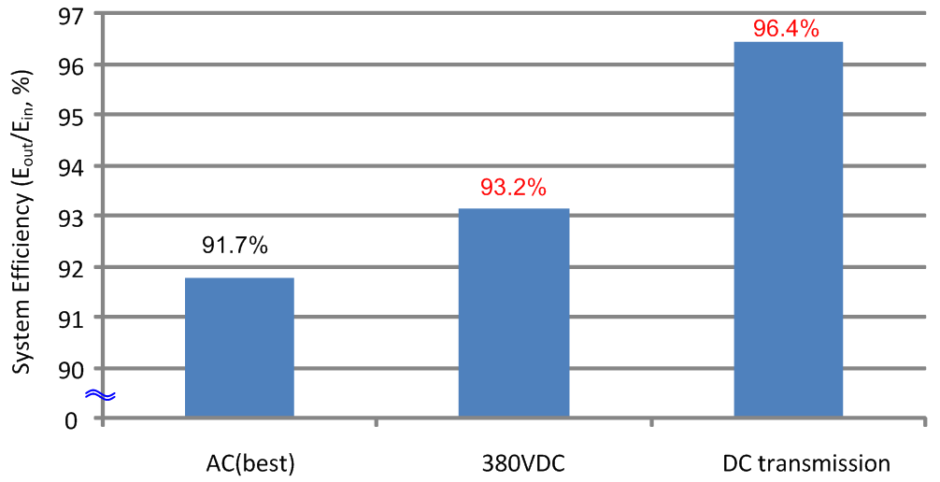
DC System Model & Design
Simulation results (Efficiency comparison for Each Power System)
# Hybrid System is not shown as it is considered to be used during period of transition only.

Slide 21
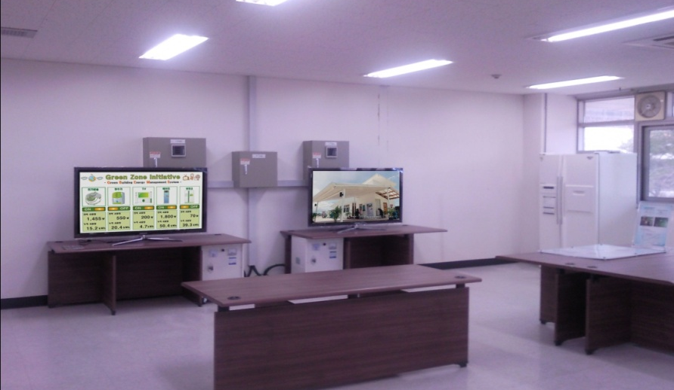
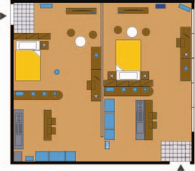
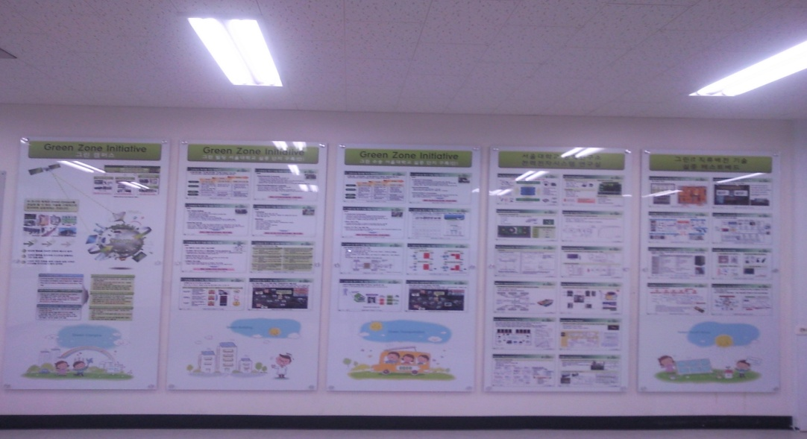
Implementation of the DC system
DC Distribution TestBed in SNU (Lab. Level)
AC/DC Conv.
air-conditioner
air-conditioner
entrance
TV
DVD
DVD
TV
PC
Lamp
Hair-dryer
Electric blanket
Lamp
Electric blanket
PC
Lamp
Hair-dryer
Vacuum
microwave
boiler
microwave
boiler
Lamp
Refrigerator
Kitchen
Kitchen
Washing-machine
Refrigerator
Washing-machine
entrance
AC
DC

Slide 22
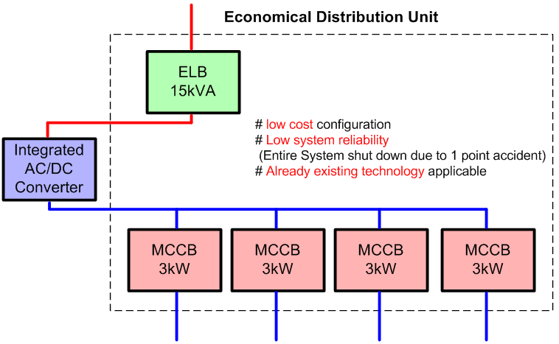
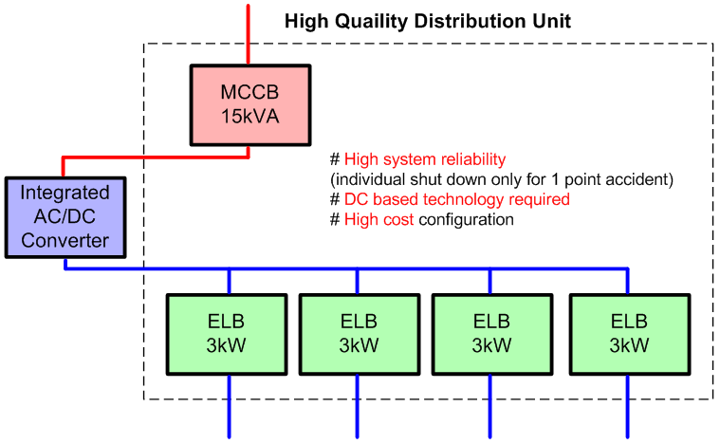
Implementation of the DC system
Distribution unit of SNU test-bed
Economic type selected due to compatibility with current device
Cost-effective DC ELB development needed to implement reliable system
A Variety of configurations possible depending on applications

Slide 23
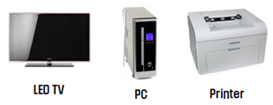
Implementation of the DC system
Categorization of Home Appliances
[with respect to the type of Power Supply Circuits]
Active PFC Type
AC only
Passive PFC Type
AC/DC Universal

Slide 24
Implementation of the DC system
DC Modification Guideline for “ Active PFC ” type appliance
55-inch LED TV
Operation Experiment
DC(left) & AC(right)
Removed Red-Box side (Space & Cost Reduction)

Slide 25
Implementation of the DC system
[55 inch LED TV] More than 4% Efficiency Increase
Comparison of Power Consumption by Load rating (Lightness variation)
Energy Consumption Comparison of AC and DC based LED TVs
[PC] 6.4% Efficiency Improvement by DC modification
Experimental Results – Active PFC Type
Energy Consumption Comparison of AC and DC based PC

Slide 26
Implementation of the DC system
[Monitor] Only 0.72% Efficiency Increased by removal of Bridge Diode
Energy Consumption Comparison of AC and DC based Monitors
Passive PFC type Appliances
Needs optimization for High Efficiency
(Component Re-Selection)
[DVD] 2.6% Efficiency Decreased
Energy Consumption Comparison of AC and DC based DVD players
Experimental Results – Passive PFC Type

Slide 27
Conclusion and Future Works
Conclusion
Introducing Green Initiatives related with DC Buildings in KOREA
Modeling, Design and Analysis of DC Distribution Power System in a Green Building
Simulation Results
- Efficiency Improvement of 1.5% (380Vdc), 4.7% (DC transmission) each
Implementation of DC building
- Modification of Home appliances, Efficiency comparison
More Efforts Needed such as Model Verification, Optimization, and Realization, etc
Future Works
Complete Realization of DC Distribution System (Pilot DC Building Model)
Optimization of High Efficiency AC-DC, DC-DC Converter
Installation of Renewable Power Sources
Secondary Battery Usage and Electric Vehicle Interface
Building Energy Management System (with Distributed Power Management Algorithm)

Slide 28
DC Building Research in SNU
ROAD MAP of Green DC Building with Green IT Project
1st Year
DC distribution Technology Realization
Comparison of AC and DC based system in Simulation
High Efficiency Integrated Power Converters (AC/DC, DC/DC)
Efficiency Evaluation of AC Devices and Verification of DC Devices
2nd Year
DC-operated Devices Development
Performance Verification of Integrated AC/DC, DC/DC Converter
Efficiency Comparison of DC and AC Appliances
DC Technology Development (DC plug, CB, Grid-connected)
Performance Verification of Protective Devices for Safety
3rd Year
Realization of DC-distributed Test bed and EMS
Connection to Energy Monitoring System based on DC distributed System and Energy Consulting Program
Realization of Residential Model with DC Technology applied
Circuit Breaker Technology Test
4th Year
Data Accumulation, Expansion
Data Accumulation (DB)
Application of ELCB
Interconnection of Renewable Energy Sources, EV, Storages

Slide 29
Thank You
Seoul National University

